Slide 1
HR ANALYTICS
Himanshu
VIMAL CHANDRAN
SHAILESH Singh
AKSHAY
TALISH raza

Slide 2
Introduction
To analyse employee attrition using HR analytics data to improve retention.
To demonstrate how HR Analytics can be leveraged to gain actionable insights and drive strategic decisions in human resource management.
Employee attrition analysis using different data management and visualization tools – Power BI, Excel, tableau, MySQL.

Slide 3
The Impact of Attrition
Financial Costs: Recruitment, onboarding, lost productivity
Knowledge Loss: Institutional knowledge walks out the door
Decreased Morale: Lowers team spirit and motivation
Damaged Reputation: High turnover can be a red flag to potential hires

Slide 4
Importance of Hr analytics
Enhances decision making with data driven insight.
HR data can help in understanding of trends and potential risk factors.
HR data will help in identifying employees at risk of leaving and intervene before its too late.
Helps in developing strategies to improve employee retention and thus enhances the organizational health and performance.

Slide 5
Key Performance indicators
Average Attrition Rate for all Department
Average Hourly rate of Male Research Scientist
Attrition rate Vs Monthly income stats
Average working years for each Department
Job Role Vs Work life balance
Attrition rate Vs Year since last promotion relation

Slide 6
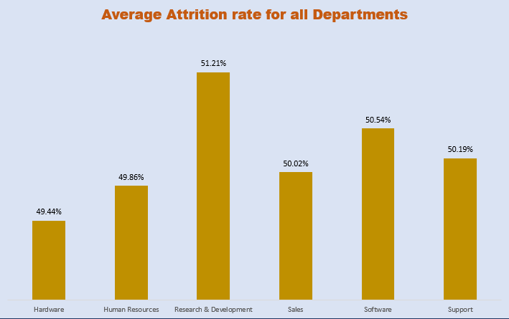
Average Attrition Rate for all Department
Research and Development Department is having highest attrition rate of 51.21% followed by Software Department with an attrition rate of 50.54%.
Hardware Department showing least attrition rate of 49.44%
Insights:
Attrition rates are fairly consistent across most departments, ranging around 50%.
The highest rate is in Research and Development since R&D can be demanding with long working hours and tight deadlines.
Analyzing the reasons for lower attrition rate in Hardware Department helps in implementing same strategies in other departments also.

Slide 7
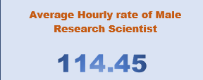
Average Hourly rate of Male Research Scientist
Average Hourly rate of Male Research Scientist is 114.45 .
This KPI by its own providing less insights. But real value comes by analysing the data with other relevant information.
Comparing with industry standards helps in understanding the competitiveness of the company in retaining the male research talent.
Comparing with female research scientist will help in understanding gender pay gap .

Slide 8
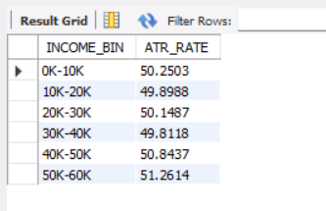
Attrition rate Vs Monthly income stats
Salary range of 50k-60k has highest attrition rate of 51.26% followed by 40k-50k and 0k – 10k with a attrition rate of 50.84% and 50.25% respectively
Insights:
High paying jobs can often come with long hours, highly demanding position. This may affect work – life balance and results in higher attrition rate.
Attrition in lower salary range is possibly due to job dissatisfaction and repetitive jobs.
To understand the reason specifically – exit interviews and job satisfaction surveys are required.

Slide 9
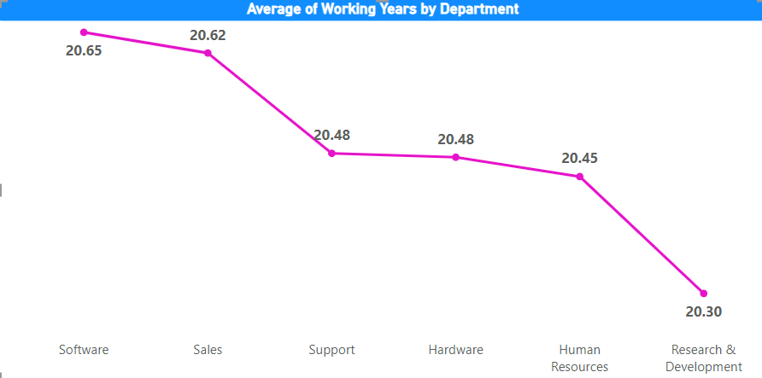
Average working years for each Department
Research and Development has least average working years of 20.30 and Software has highest average working years of 20.65
Insights:
Research and Development department with highest attrition rate and lowest working years confirms that more focus should be given to this department.
Higher turnover in this departments suggests potential issues such as high stress, lower job satisfaction, or insufficient career development opportunities.
Similarly, for Software department with higher working years focus should be given on knowledge transfer and succession planning.

Slide 10
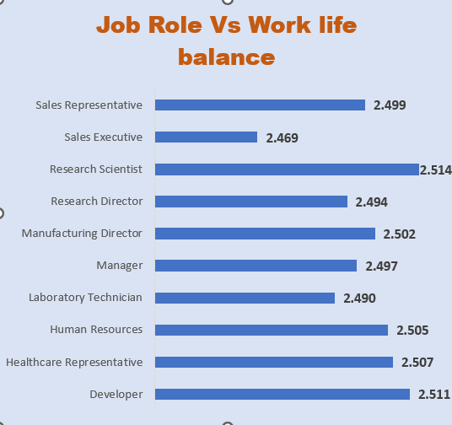
Job Role Vs Work life balance
Research Scientist provided a highest rating of 2.514 for work life balance whereas sales executive provided least rating of 2.469
Insights:
Employees in sales often face irregular hours, high demands, and increased stress.

Slide 11
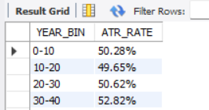
Attrition rate Vs Year since last promotion relation
Highest attrition rate in the range of employees who doesn’t get a promotion for last 30-40 years .
Insights:
Employees who do not receive promotions within a reasonable timeframe may feel undervalued, leading to decreased motivation and increased likelihood of leaving the organization.

Slide 12
Dashboard
Excel
Power bi
Tableau

Slide 13
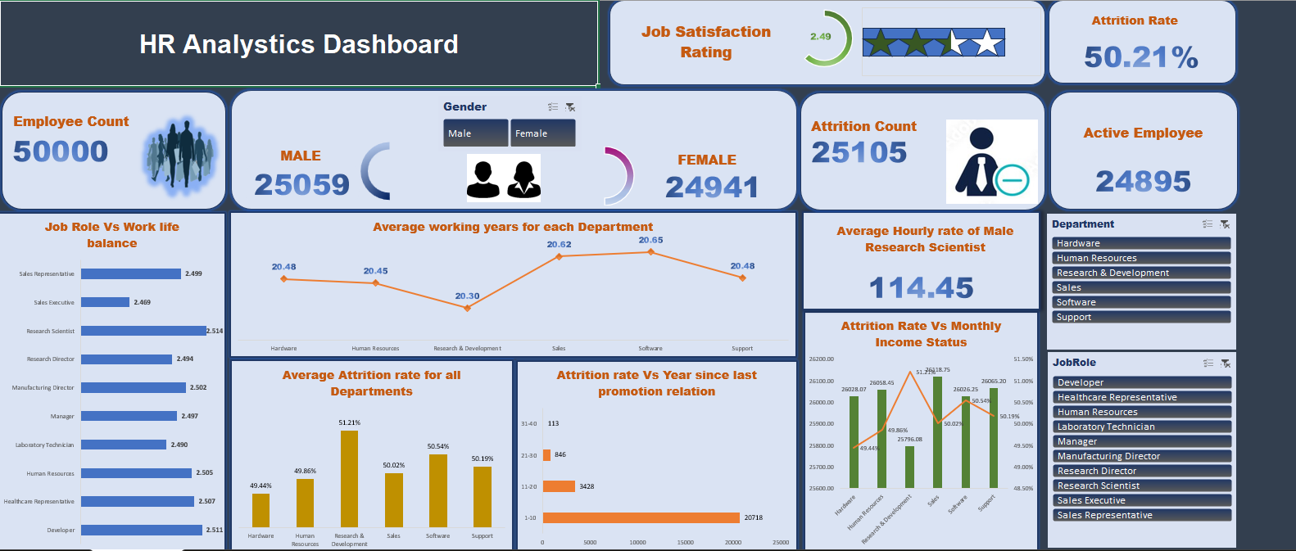

Slide 14
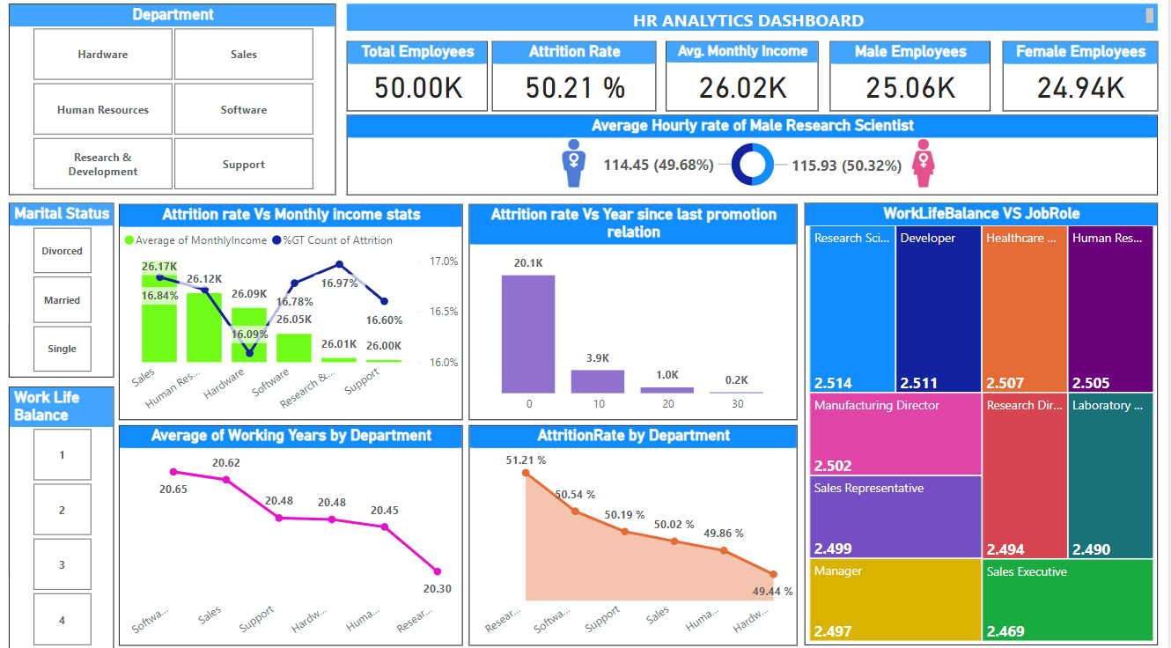

Slide 15
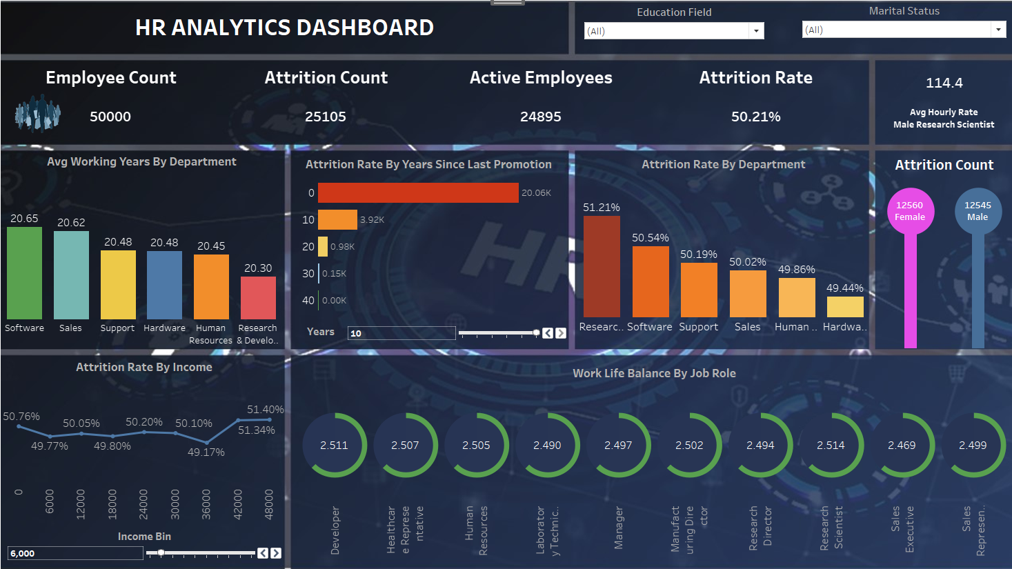

Slide 16
conclusion
HR analytics helps in creating a framework and provides a data driven insights for implementing informed decision making.
Conduct Exit Interviews and Surveys to understand the issue specifically.
Implementing feedback mechanism for understanding employee concerns.

Slide 17
Thank YOu

